Slide 1
Superstore Dashboard
360° view of performance of the store
https://www.tableau.com/learn/training

Slide 2
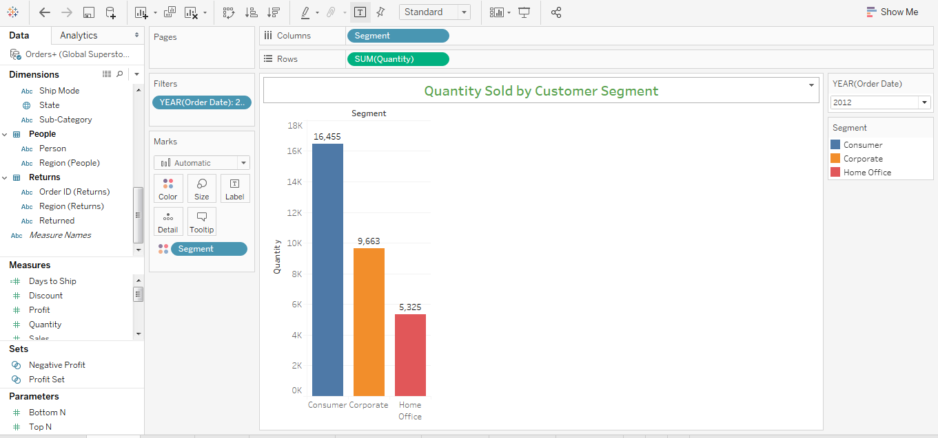
Customer Performance – Total quantity by segment

Slide 3
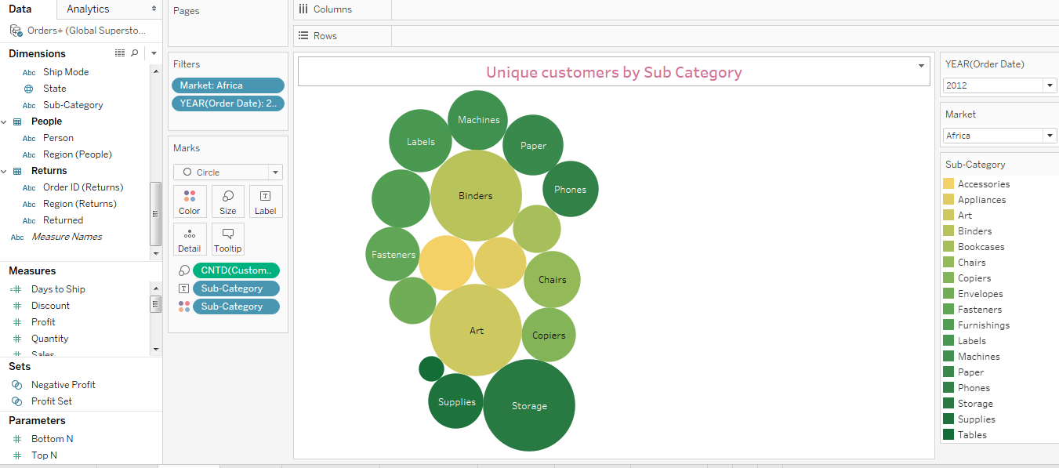
Customer Performance – Customer COUNT by Category

Slide 4
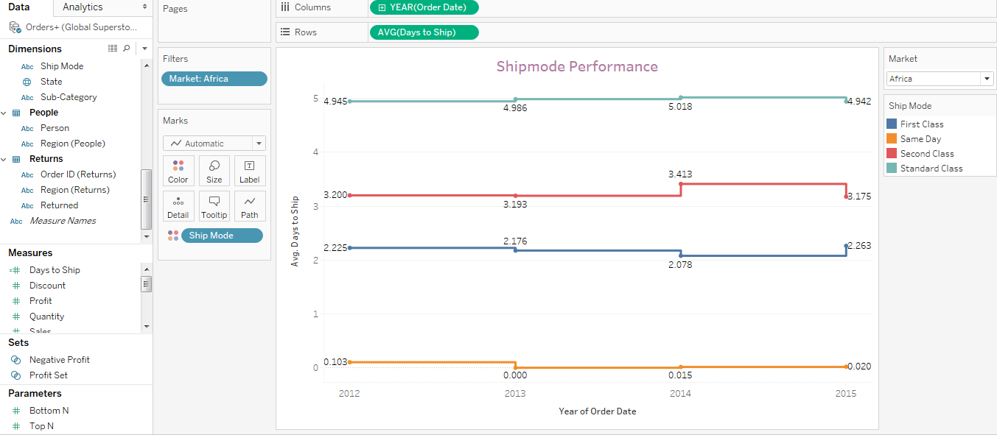
SUPPLY CHAIN – SHIPMODE PERFORMANCE

Slide 5
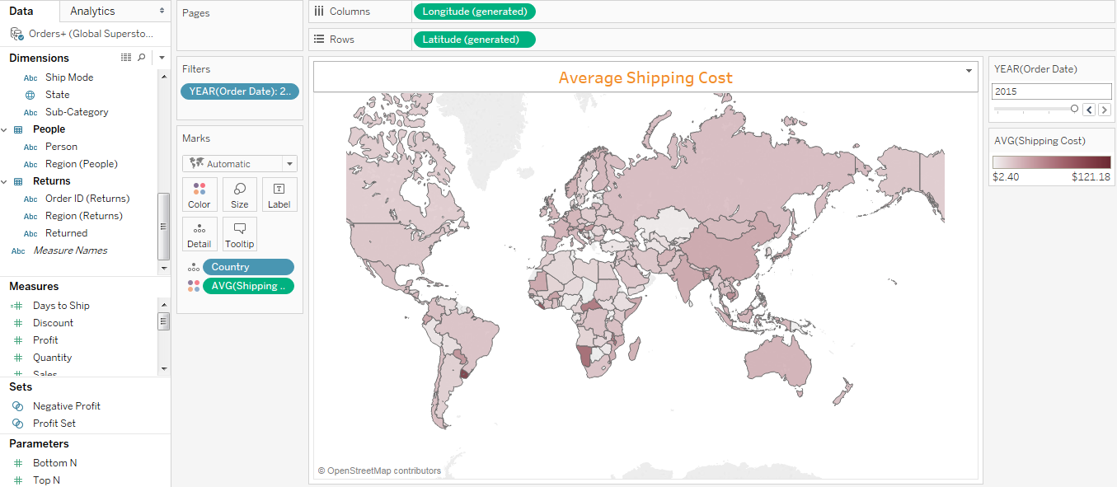
Customer Performance – AVG SHIPPING COST BY COUNTRY

Slide 6
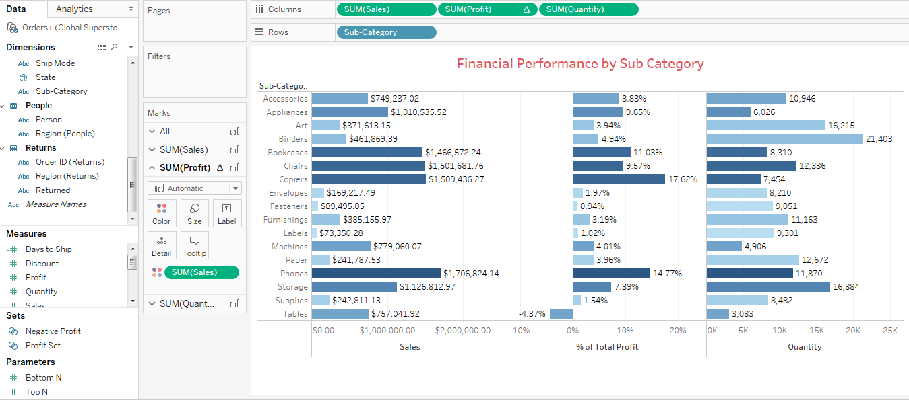
PRODUCT Performance – FINANCIAL PERFORMANCE

Slide 7
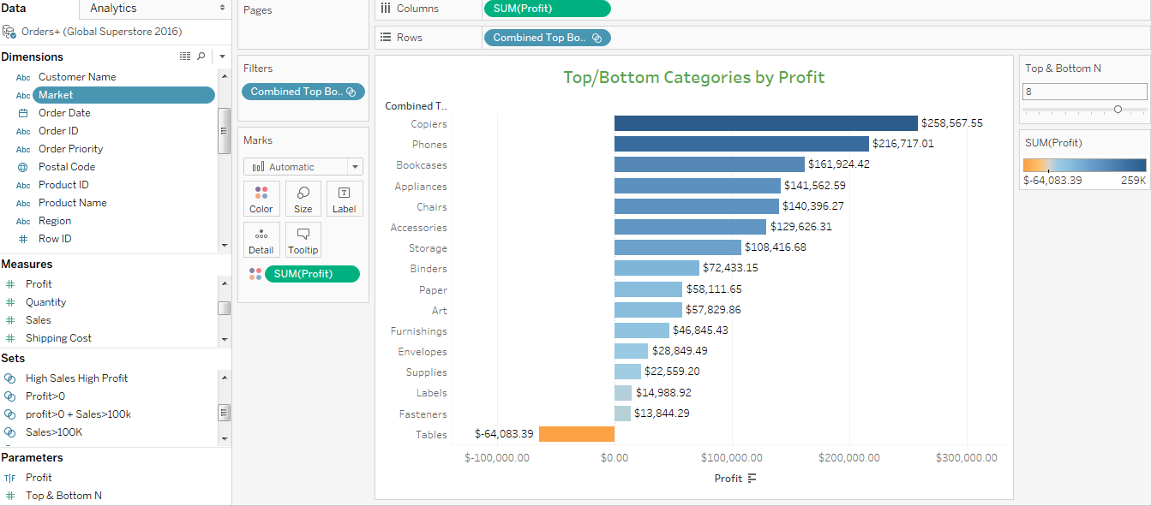
PRODUCT Performance – CATEGORIES BY PROFIT

Slide 8
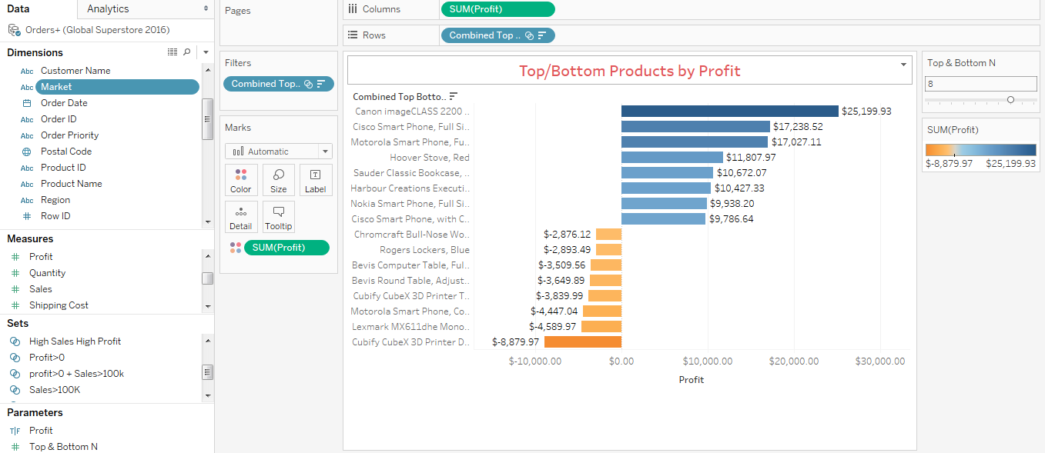
PRODUCT Performance – PRODUCTS BY PROFIT

Slide 9
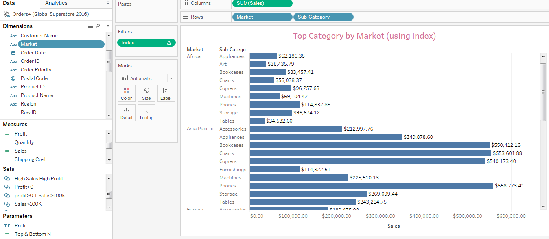
PRODUCT Performance – TOP 10 CATEGORIES BY MARKET

Slide 10
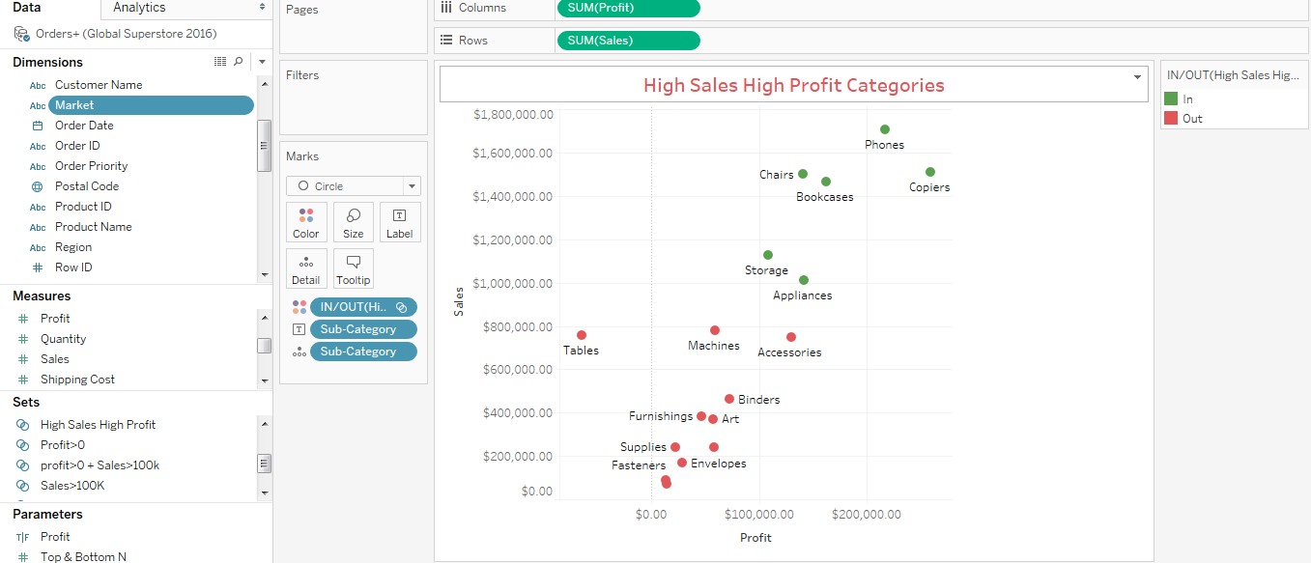
PRODUCT Performance – SALES vs PROFIT BY categories

Slide 11
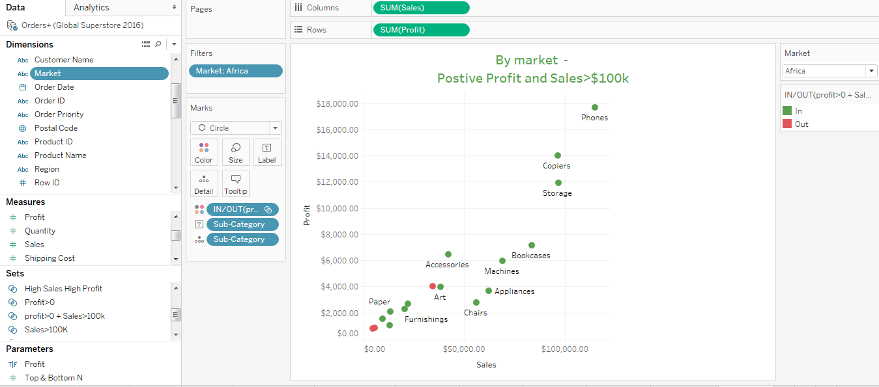
PRODUCT Performance – High performance categories

Slide 12
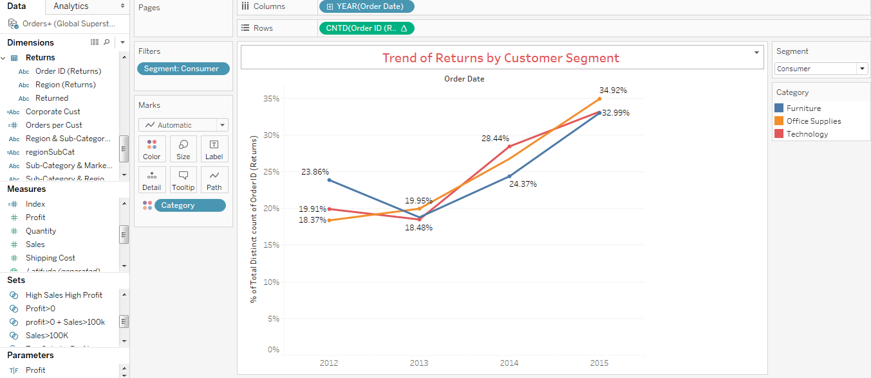
RETURNS TREND – returns by customer segment

Slide 13
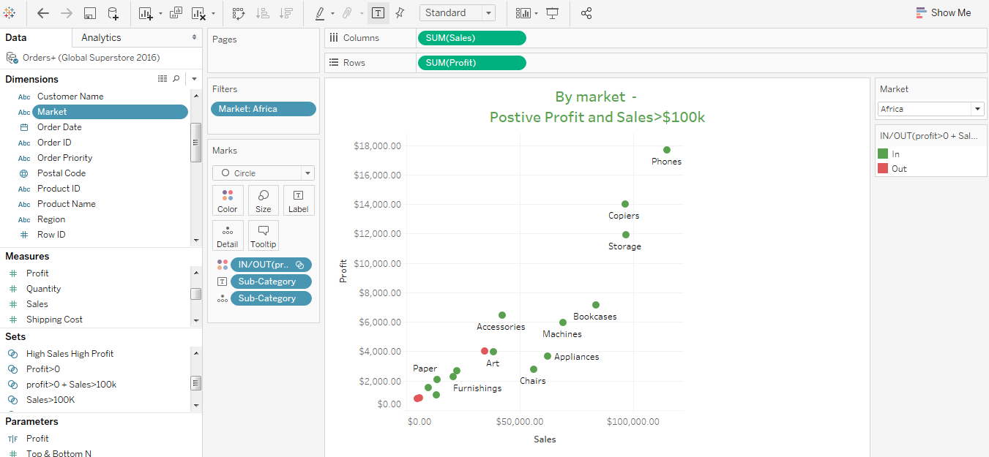
GEOGRAPHY – PROFITABLE MARKET

Slide 14
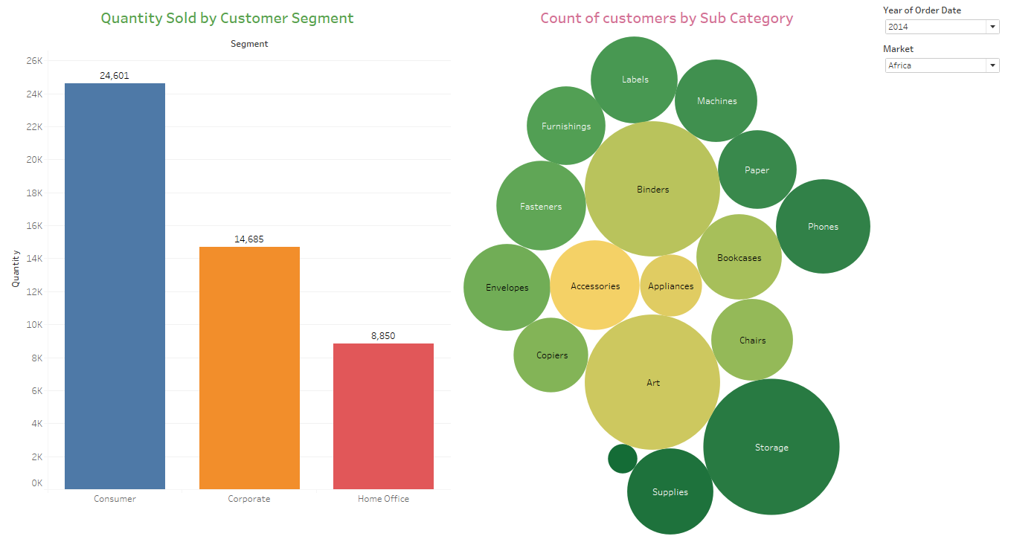
CUSTOMERS 360°

Slide 15
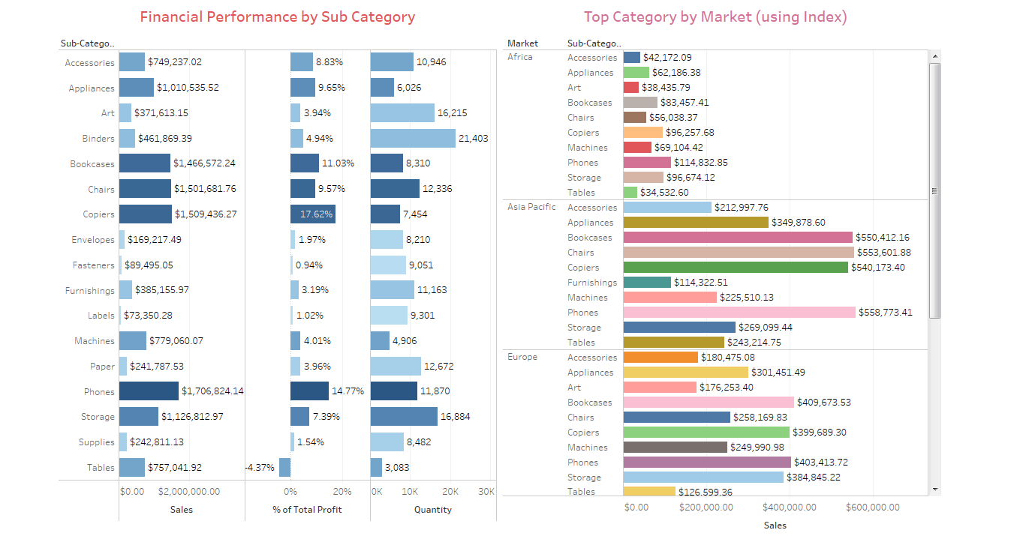
PRODUCT 360°

Slide 16
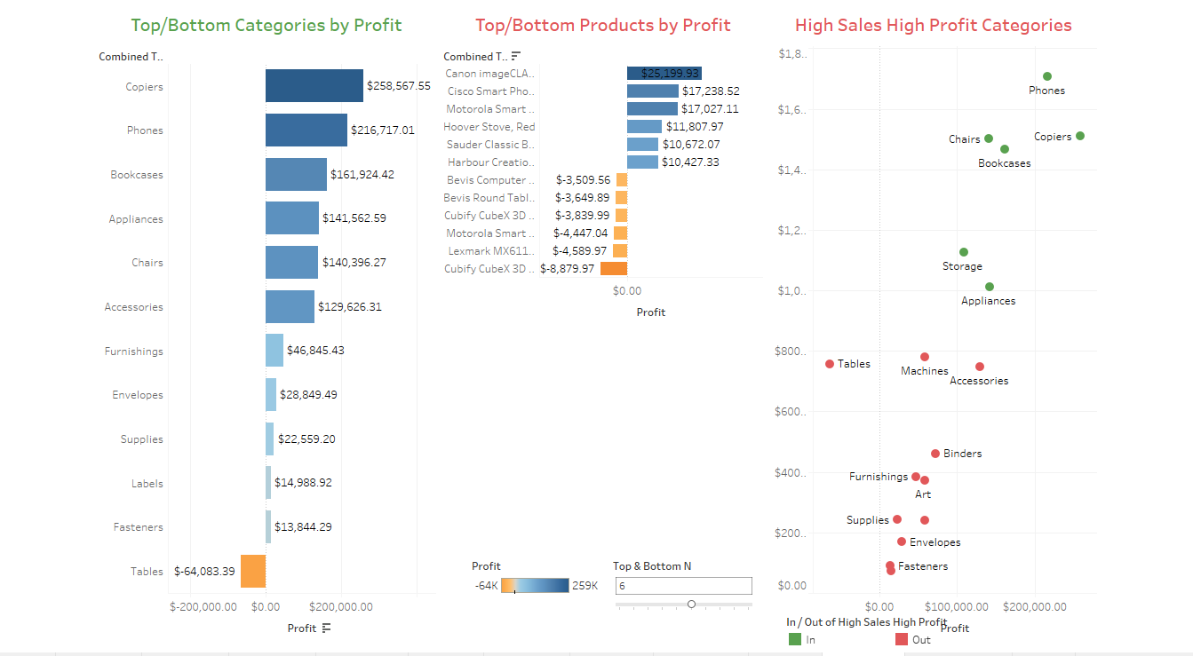
PRODUCT 360°

Slide 17
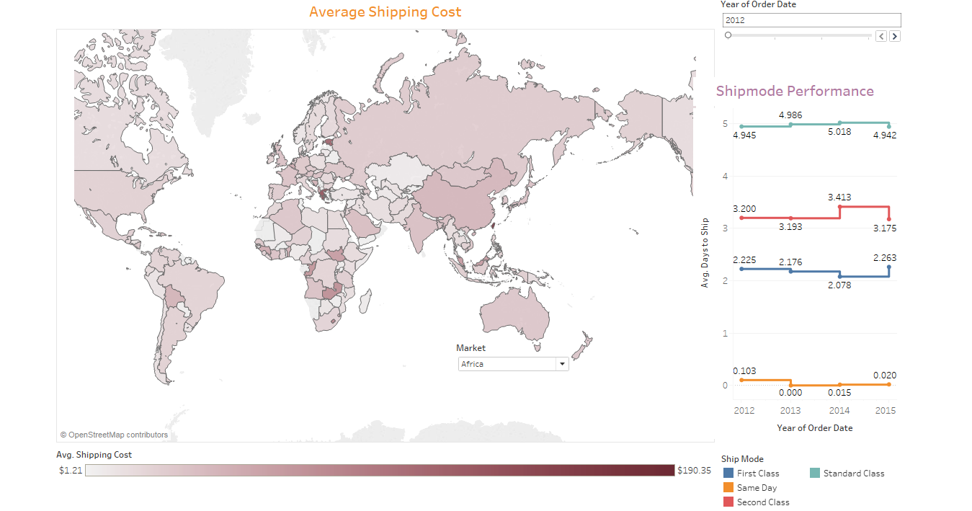
SUPPLY CHAIN 360°

Slide 18
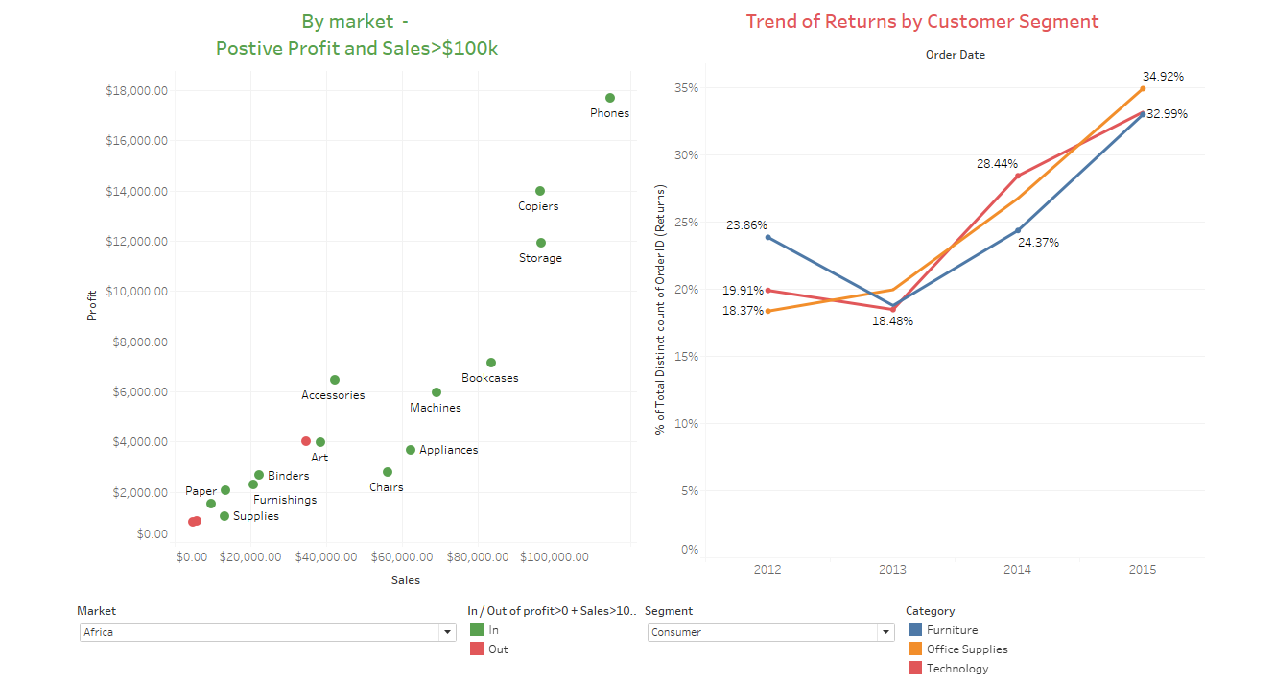
RETURNS 360°

